Slide 1
Chiba Campaign 2021
Daily Report (07/26~) :
Tropospheric NO₂ column data from
TROPOMI and 4(+1)AZ-MAXDOAS
2021/08/05
Saito Hikaru(齊藤 輝)

Slide 2
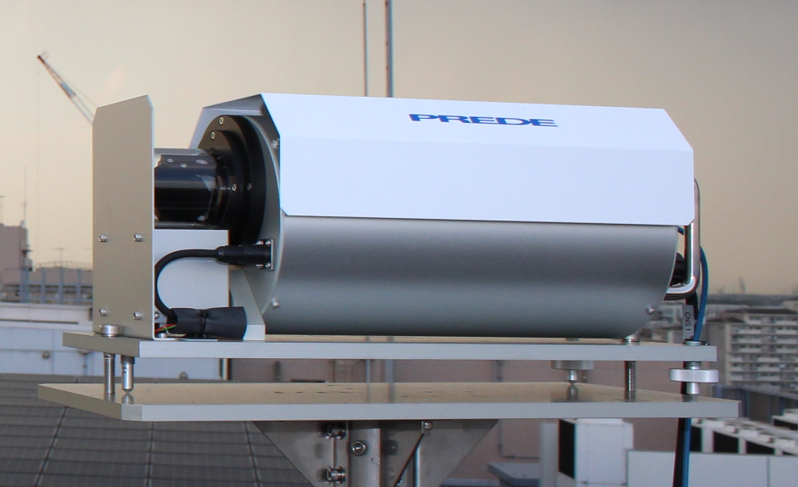
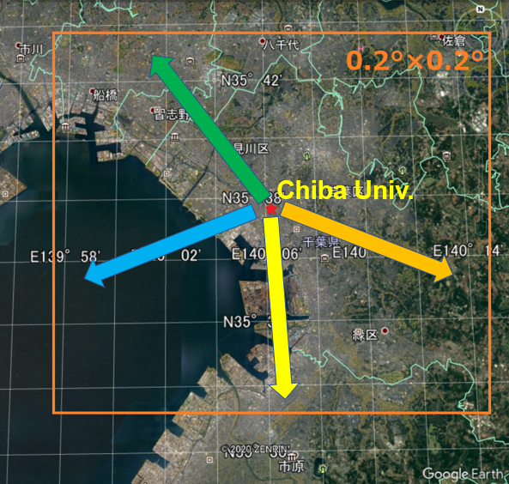
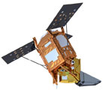
Tropospheric NO₂ column density data
4AZ-MAXDOAS (Ground-based)
Plot…
・All measurements
・Daily average
Additionally…
5th instrument on the NE direction (N48.5°E )
is temporary running (20210726~) and
data are compared.
TROPOMI (TROPOspheric Monitoring Instrument) (Satellite-based)
Plot…
・Daily 0.2°×0.2° average, cloud<0.2 data
・Standard Deviation in pixels of 1-day data
1995
2002
2004
20km

Slide 3
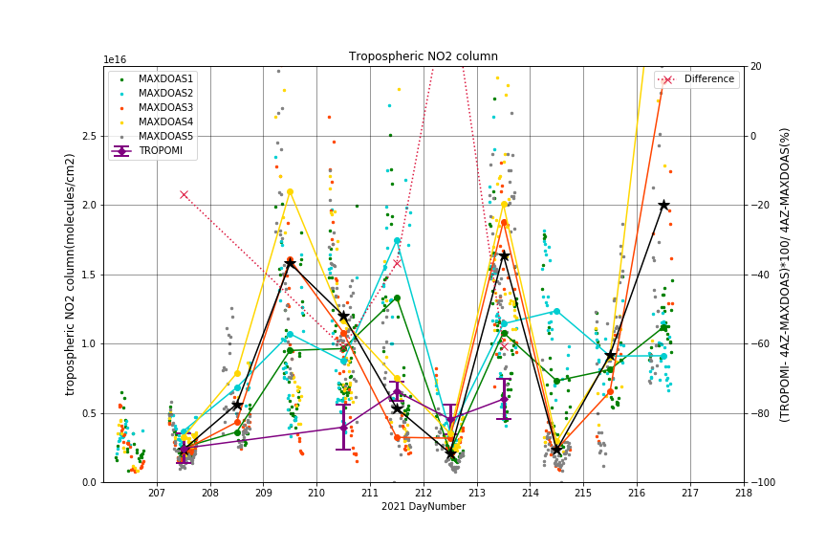
07/26

Slide 4
Discussion(MAX-DOAS#5)
Generally, NO2 data from MAXDOAS#5 showed the tendency of the middle of the #1(North) and #3(East) (e.g. DN211 and 213).
  This result is consistent with the positional relationship (See the map).
  Slightly more correlated with #3 than #1? I will check that.

